Slide 1

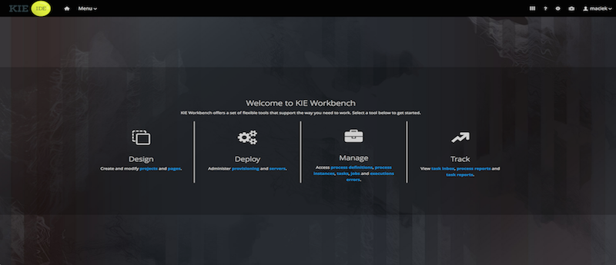
Introduction to jBPM
Notes:
Welcome back to the forth module of data science.

Slide 2
Agenda
01
02
03
jBPM Components
architecture
jBPM.org
04
05
Quiz
Conclusion

Slide 3
JBoss BPM Suite Key Components

Slide 4
jBPM Components
JBoss BPM Central (Business Central)
Business Central is a web-based application for creating, editing, building, managing, and monitoring Red Hat JBoss BPM Suite business assets. It also allows execution of business processes and management of tasks created by those processes.
Business Activity Monitoring Dashboards
The Business Activity Monitor (BAM) dashboard provides report generation capabilities.
It enables you to use a pre-defined dashboard and even create your own customized dashboard.
Maven Artifact Repository
Red Hat JBoss BPM Suite projects are built as Apache Maven projects and the default location of the Maven repository is WORKING_DIRECTORY/repositories/kie. You can specify an alternate repository location by changing the org.guvnor.m2repo.dir property.
Each project builds a JAR artifact file called a KJAR. You can store your project artifacts and dependent JAR files in this repository.

Slide 5
jBPM Components
Execution Engine (KIE Server)
The Red Hat JBoss BPM Suite execution engine is responsible for executing business processes and managing the tasks, which result from these processes. Business Central provides a user interface for executing processes and managing tasks.
Business Central Repository
The business artifacts of a Red Hat JBoss BPM Suite project, such as process models, rules, and forms, are stored in Git repositories managed through the Business Central. You can also access these repositories outside of Business Central through the Git or SSH protocols.

Slide 6
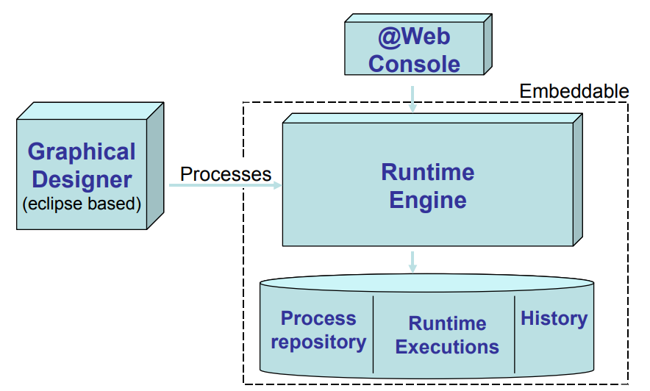
jBPM Components

Slide 7
jBPM Architecture

Slide 8
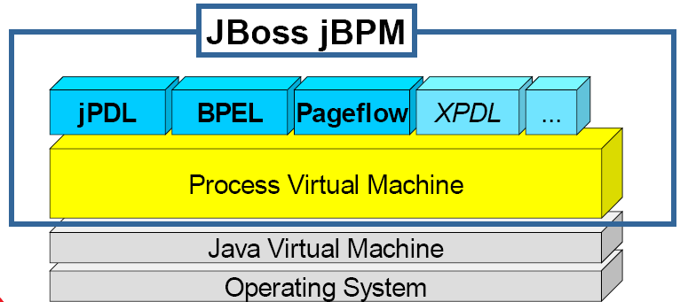
jBPM High Level Architecture

Slide 9
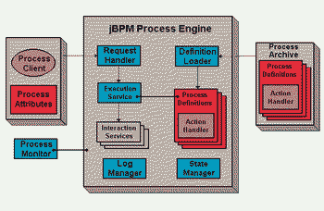
jBPM High Level Architecture

Slide 10
jBPM.org
jBPM Website

Slide 11
Quiz
Introduction to jBPM

Slide 12
Quiz
Which is jBPM Execution Server?
KIE
Process Server
EAP
Wildfly

Slide 13
Answers
Which is jBPM Execution Server?
KIE
Process Server
EAP
Wildfly

Slide 14
Quiz
Which is community versions from below list?
jBPM
Process Automation Manager (PAM)
jBoss Business Process Management System (BPMS)
BRMS

Slide 15
Answers
Which is community versions from below list?
jBPM
Process Automation Manager (PAM)
jBoss Business Process Management System (BPMS)
BRMS

Slide 16
Quiz
Which application server used with jBPM?
EAP
WAS
WebLogic
Wildfly

Slide 17
Answers
Which application server used with jBPM?
EAP
WAS
WebLogic
Wildfly

Slide 18
Conclusion

Slide 19

India : +91-7847955955
US : 1-800-216-8930 (TOLL FREE)
sales@intellipaat.com
24X7 Chat with our Course Advisor
Notes:
Thank you!

